Slide 1
Operators and Expressions
Dr. Nachiket Tapas

Slide 2
Review
main()
{
int a, b, c, d;
a = 15;
b = 10;
c = ++a - b;
printf(“a = %d b = %d c = %d\n”,a, b, c);
d = b++ +a;
printf(“a = %d b = %d d = %d\n”,a, b, d);
printf(“a/b = %d\n”, a/b);
printf(“a%%b = %d\n”, a%b);
printf(“a *= b = %d\n”, a*=b);
printf(“%d\n”, (c>d) ? 1 : 0);
printf(“%d\n”, (c<d) ? 1 : 0);
}

Slide 3
Output
a = 16 b = 10 c = 6
a = 16 b = 11 d = 26
a/b = 1
a%b = 5
a *=b = 176
0
1

Slide 4
Review
main()
{
float a, b, c, x, y, z;
a = 9;
b = 12;
c = 3;
x = a – b / 3 + c * 2 - 1;
y = a – b / (3 + c) * (2 - 1);
z = a – (b / (3 + c) * 2) - 1;
printf(“x = %f\n”, x);
printf(“y = %f\n”, y);
printf(“z = %f\n”, z);
}

Slide 5
Output
x = 10.000000
y = 7.000000
z = 4.000000

Slide 6
Interesting Question
#include<stdio.h>
void main() {
float no1 = 10.2;
float no2 = 20.4;
float sum = 0;
sum = no1 + no2;
printf(“Sum: %f”, sum);
}
What is the output in this case?

Slide 7
Special Operators
sizeof()
printf(“%d”, sizeof(int));
Did you try the following? What did you get?
printf(“%d”, sizeof(5.2));
Did you get 4 or 8?

Slide 8
Default decimal number
By default, C programming considers decimal values as double.
That is why you get output as 8 and not 4.
Remember the value 5.2 used by us is literal constant. If you declare a float variable and find its size, you will get 4 as output.
Another type of constant is called symbolic constant
#define PI 3.14
Constant variable
const int I = 10;

Slide 9
Special Operators
comma operator
value = (x=5, y=7, x+y);
printf(“%d”, value);
#include<stdio.h>
void main(){
int value, x, y;
value = (x=5, y=7, x+y);
printf("%d", value);
}

Slide 10
What is the result?
[ 7 + 8 { 4 × ( 6 + 4 × 3 ) × 4}]
[ 7 + 8 { 4 x ( 6 + 12 ) x 4 } ]
[ 7 + 8 { 4 x 18 x 4 } ]
[ 7 + 8 { 72 x 4 } ]
[ 7 + 8 x 288 ]
[ 7 + 2304 ]
O/P: 2311

Slide 11
What about this?
45 + 3 { 34 – 18 – 14 } ÷ 3 [ 17 + 3 × 4 – ( 2 × 7 ) ]
45 + 3 { 16 – 14 } / 3 [ 17 + 3 x 4 – ( 2 x 7 ) ]
45 + 3 x 2 / 3 [ 17 + 3 x 4 – ( 2 x 7 ) ]
45 + 3 x 2 / 3 [ 17 + 3 x 4 – 14 ]
45 + 3 x 2 / 3 [ 17 + 12 – 14 ]
45 + 3 x 2 / 3 [ 29 – 14 ]
45 + 3 x 2 / 3 x 15
45 + 6 / 3 x 15
45 + 2 x 15
45 + 30
O/P: 75

Slide 12
Operator Precedence

Slide 13
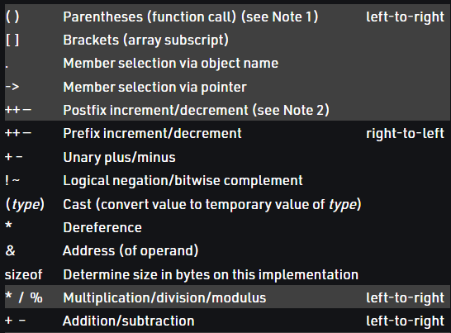
Operator Precedence in C

Slide 14
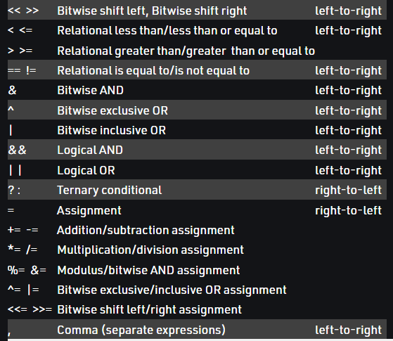
Contd.

Slide 15
When to use associativity?
We only use associativity when we have two or more operators that have the same precedence in an expression.
The point to note here is that associativity is not applicable when we are defining the order of evaluation of operands with different levels of precedence.
All operators with the same precedence have same associativity This is necessary, otherwise, there won’t be any way for the compiler to decide evaluation order of expressions which have two operators of same precedence and different associativity. For example + and – have the same associativity.

Slide 16
Truth Table
Precedence | Associativity
Different | Same
Same | Different
Precedence | Associativity
Different | Same/Different
Same | Same

Slide 17
Example

Slide 18
Example

Slide 19
Example
12 + 3 – 4 / 2 < 3 + 1
12 + 3 – 2 < 3 + 1
15 – 2 < 3 + 1
13 < 3 + 1
13 < 4
O/P: 0

Slide 20
Example
X = -5 * 4 / 2 * 3 + -1 * 2;

Slide 21
Caution
Operator precedence if not used correctly, can give absurd results.
Always use parenthesis to define precedence.

Slide 22
Code
#include <stdio.h>
main() {
int a = 20;
int b = 10;
int c = 15;
int d = 5;
int e;
e = (a + b) * c / d; // ( 30 * 15 ) / 5
printf("Value of (a + b) * c / d is : %d\n", e );
e = ((a + b) * c) / d; // (30 * 15 ) / 5
printf("Value of ((a + b) * c) / d is : %d\n" , e );
e = (a + b) * (c / d); // (30) * (15/5)
printf("Value of (a + b) * (c / d) is : %d\n", e );
e = a + (b * c) / d; // 20 + (150/5)
printf("Value of a + (b * c) / d is : %d\n" , e );
return 0;
}
Value of (a + b) * c / d is : 90
Value of ((a + b) * c) / d is : 90
Value of (a + b) * (c / d) is : 90
Value of a + (b * c) / d is : 50

Slide 23
Is the following true?
5 + 5 = = 10 || 1 + 3 = = 5
!(5 + 5 >=10)
5 > 10 || 10 < 20 && 3 < 5
10 ! = 15 && !(10<20) || 15 > 30

